Slide 1
Operation Research
Lec. # 1
1

Slide 2
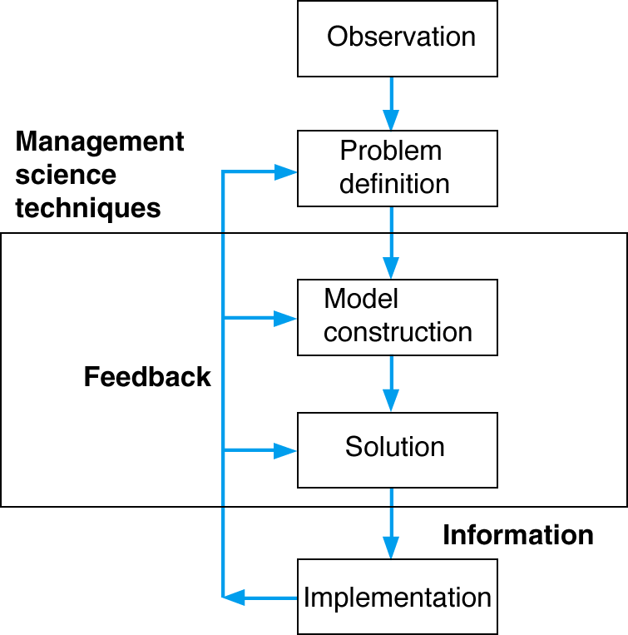
The Management Science Process
Management science is a scientific approach to solving management problems.

Slide 3
Steps in the Management Science Process
Observation - Identification of a problem that exists (or may occur soon) in a system or organization.
Definition of the Problem - problem must be clearly and
consistently defined, showing its boundaries and interactions
with the objectives of the organization.
Model Construction - Development of the functional mathematical relationships that describe the decision variables, objective function and constraints of the problem.
Model Solution - Models solved using management science techniques.
Model Implementation - Actual use of the model or its solution.

Slide 4
Break-Even Analysis
The volume at which total revenue equals total cost is called the break-even point.
Profit at break-even point is zero.

Slide 5
Components of Break-Even Analysis
The three components of break-even analysis are
volume,
cost,
and profit.
Chapter 1- Management Science

Slide 6
Costs
Two type of costs are typically fixed costs and variable costs.
Fixed costs are independent of volume and remain constant.
Variable costs are determined on a per-unit basis. Thus, total variable costs depend on the number of units produced. Variable costs include such items as raw materials and resources, direct labor, packaging, material handling, and freight.

Slide 7
Model Building:
Break-Even Analysis
Fixed Costs (c_{f}) - costs that remain constant regardless of number of units produced.
Variable Cost (c_{v}) - unit production cost of product.
total variable cost = vc_{v}
where c_{v} = variable cost per unit and v = volume (number of units) sold.
Total Cost (TC) - total fixed cost plus total variable cost.
Profit (Z) - difference between total revenue vp (p = unit price) and total cost, i.e.
Z = vp - c_{f} - vc_{v}

Slide 8
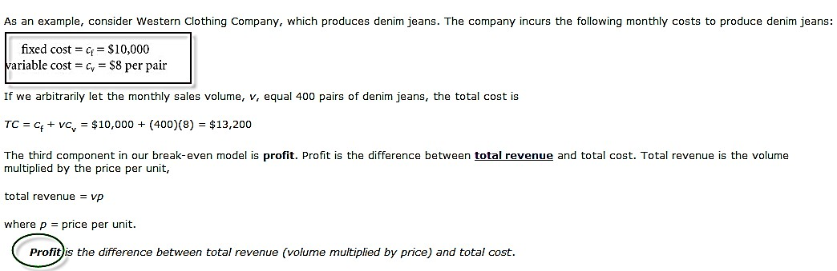
Example #1

Slide 9
Computing the Break-Even Point
The break-even point is that volume at which total revenue equals total cost and profit is zero:
v = c_{f}/(p - c_{v})
(Break-Even Point)
9

Slide 10
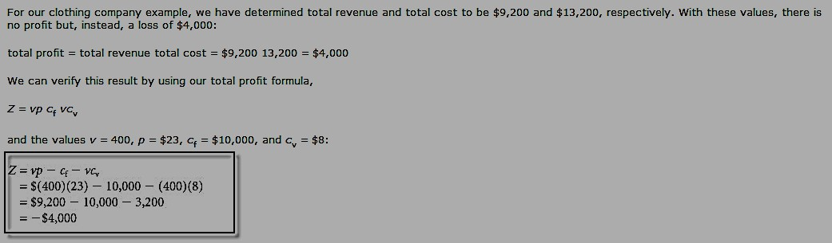
Example #2
Chapter 1- Management Science
10

Slide 11
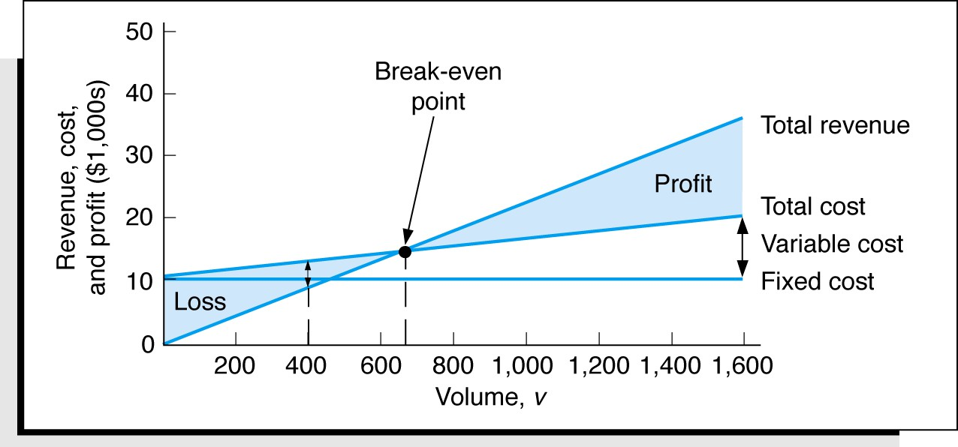
Break-Even Analysis
Graphical Solution

Slide 12
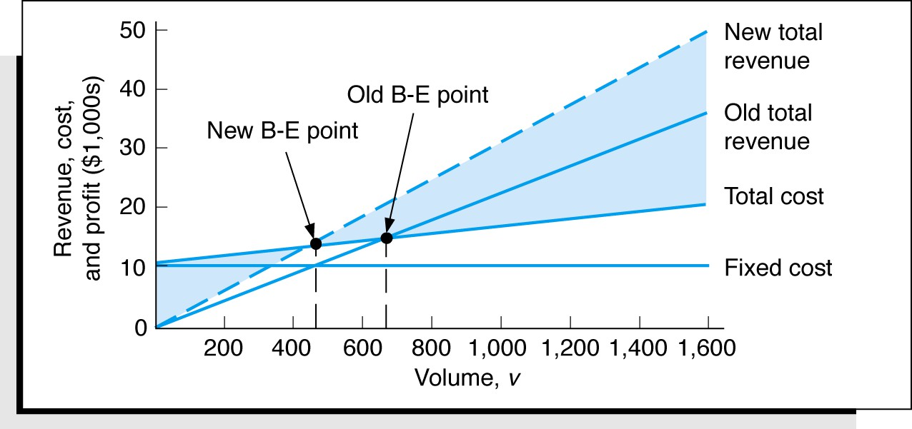
In general, an increase in price lowers the break-even point, all other things held constant.
Sensitivity Analysis - Break-even Model with a Change in
Price

Slide 13
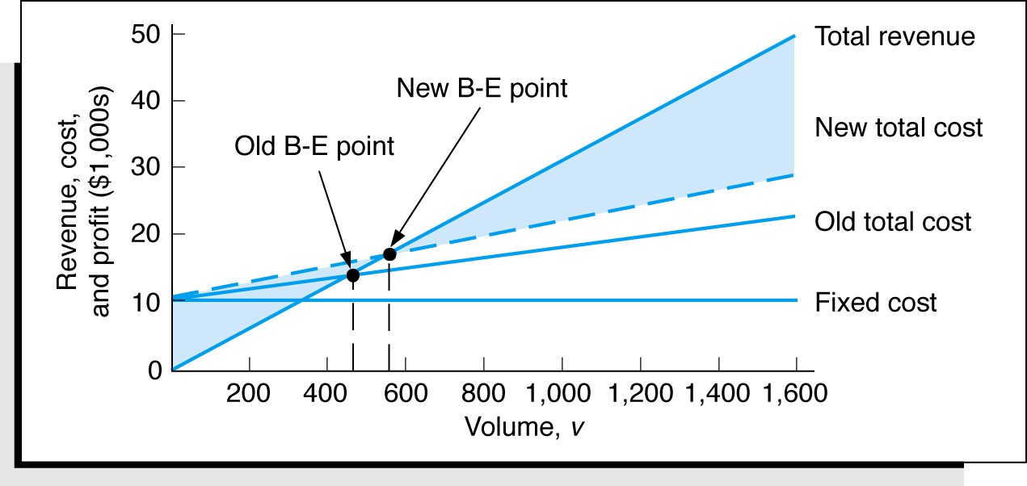
In general, an increase in variable costs will increase the
break-even point, all other things held constant.
Sensitivity Analysis - Break-Even Model with a Change in
Variable Cost

Slide 14
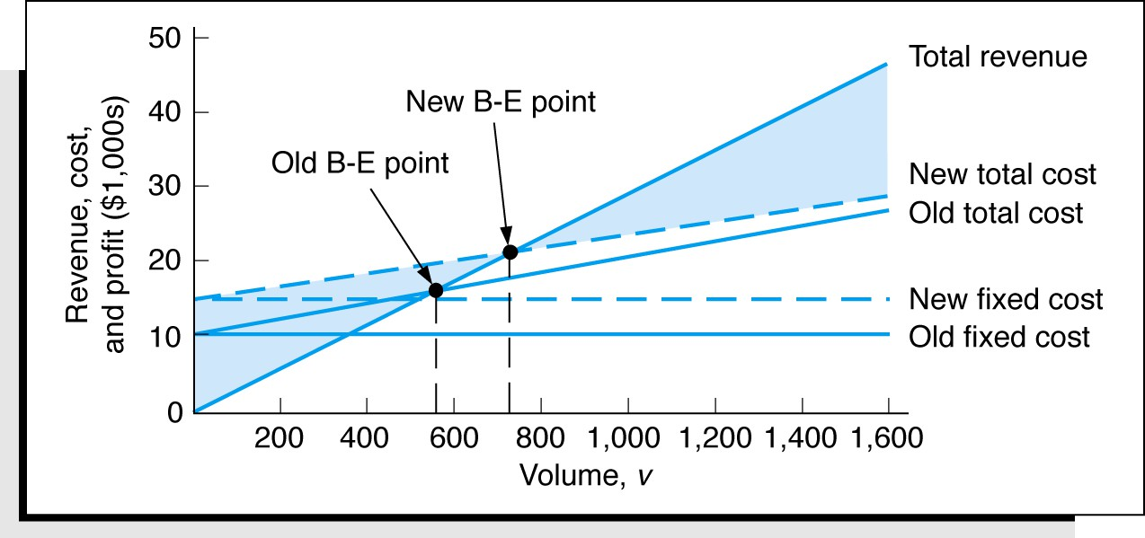
In general, an increase in fixed costs will increase the break-even point, all other things
held constant.
Sensitivity Analysis - Break-Even Model with a Change in
Fixed Cost

Slide 15
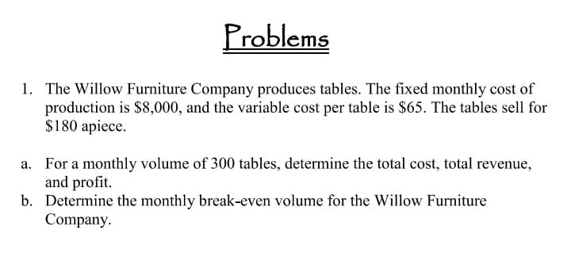
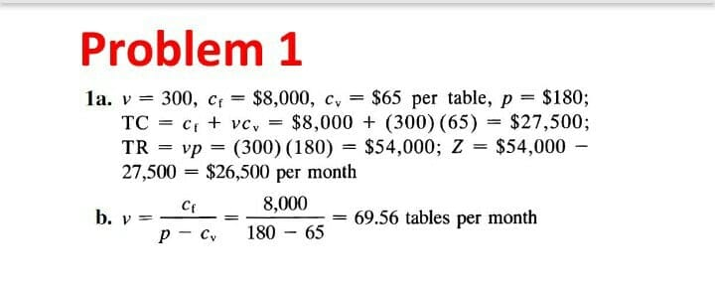

Slide 16
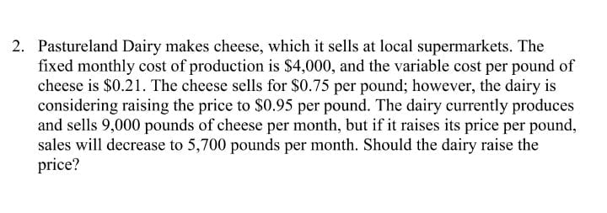
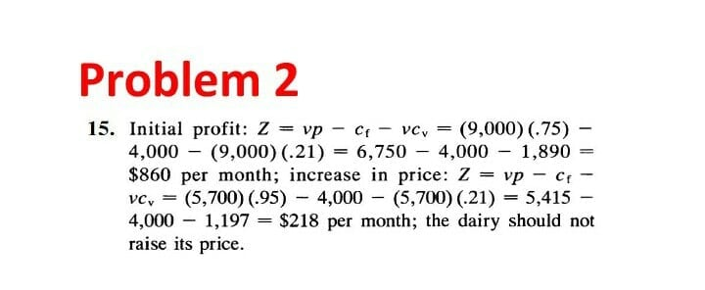

Slide 17
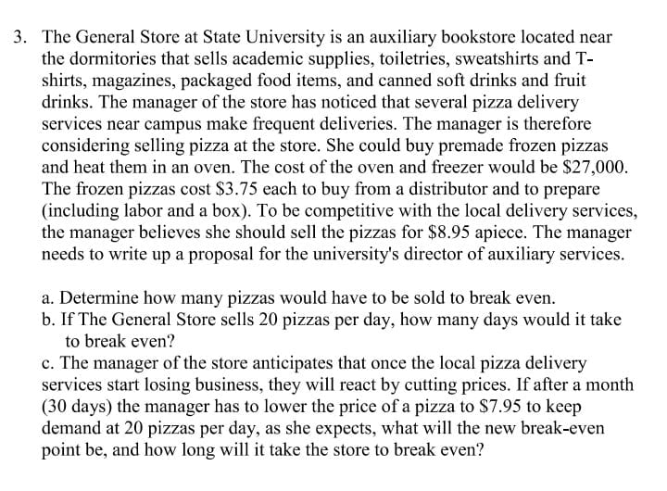

Slide 18
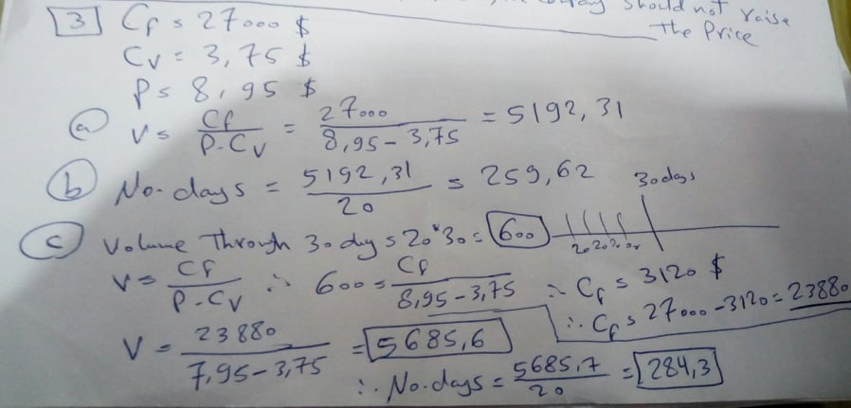

Slide 19
Thank You

